Slide 1
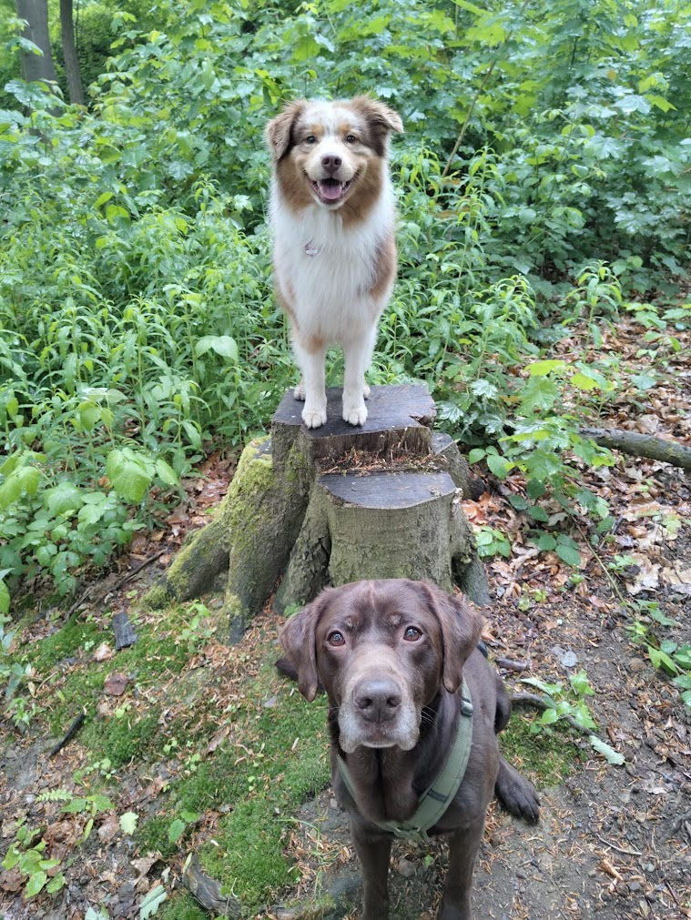


About Tim Wolf
Focus
Certifications
Cloud Identity
Ex-MSFT, MCT
From
Hobbies
Picture
Semperis, Germany
My Blog
Contact
www.azurehero.de

Slide 2


Slide 3
DISCLAIMER:
THIS IS A DEMO only Session. Slides are just backup content. If you have question, let me know!

Slide 4
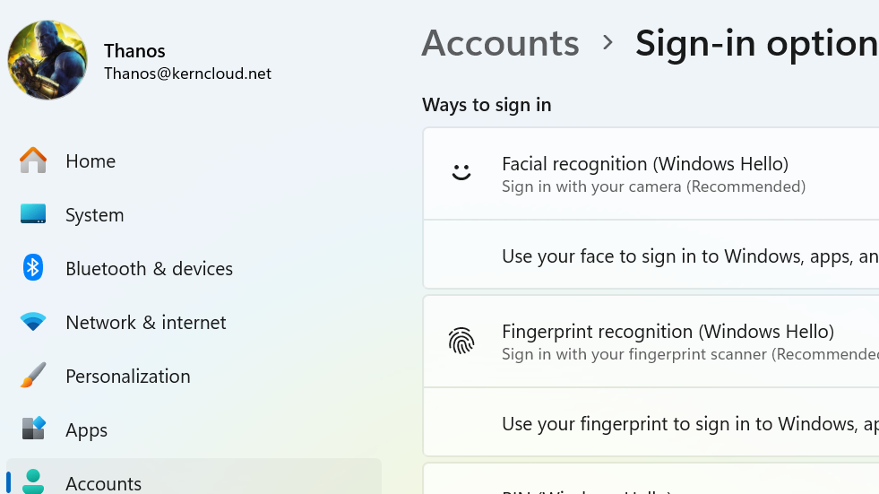

Slide 5
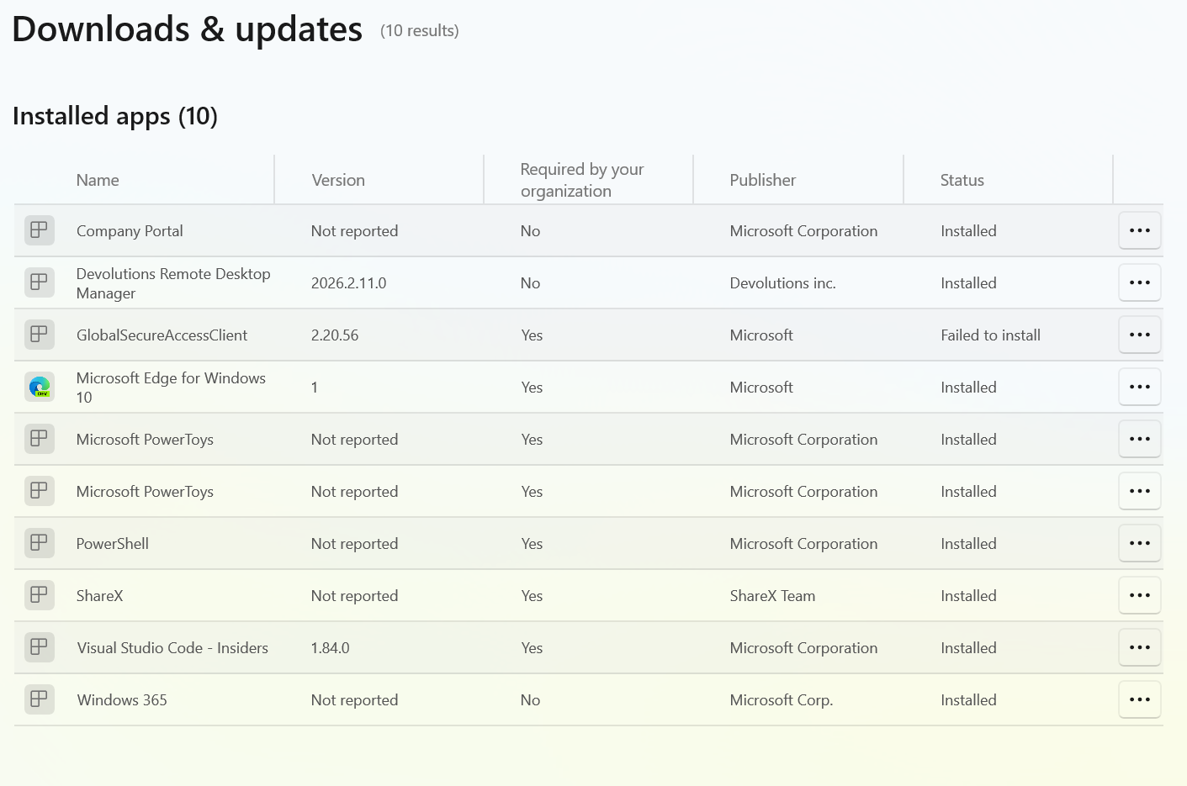

Slide 6
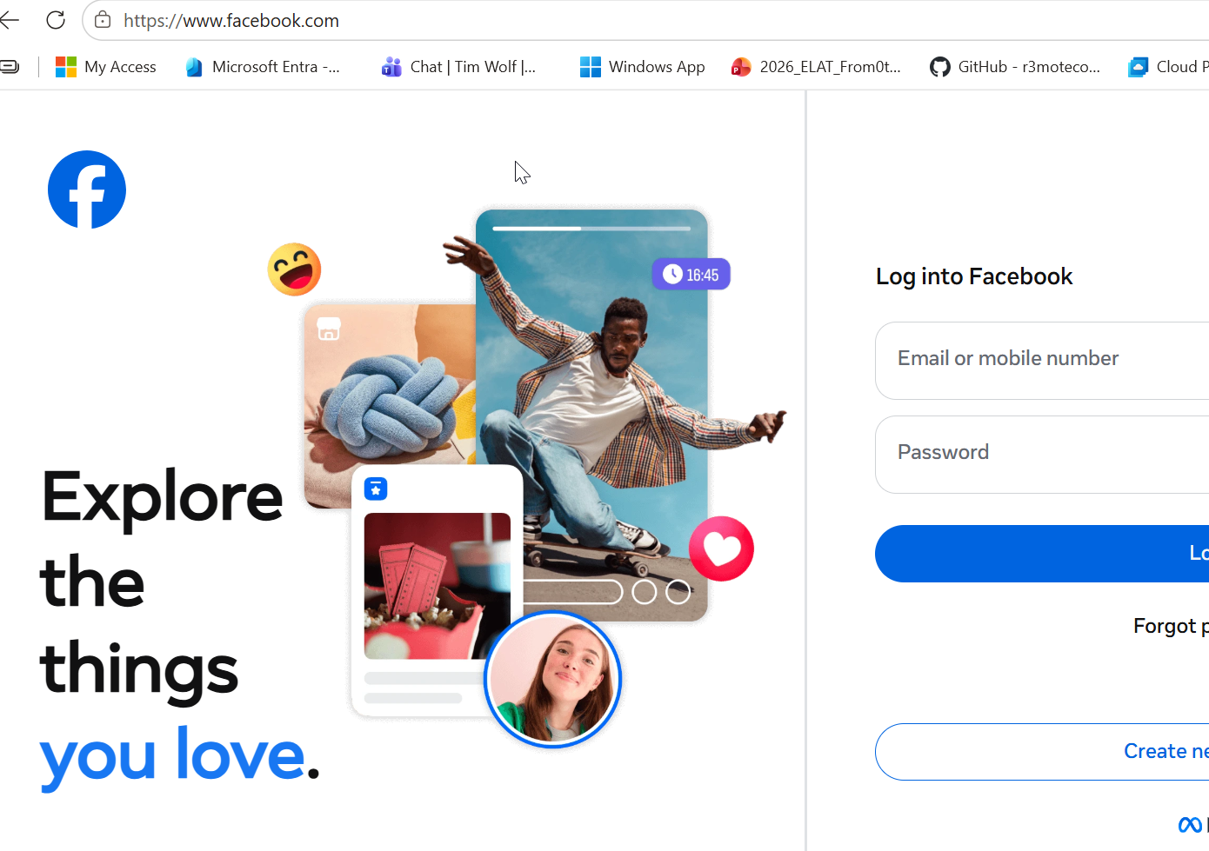

Slide 7
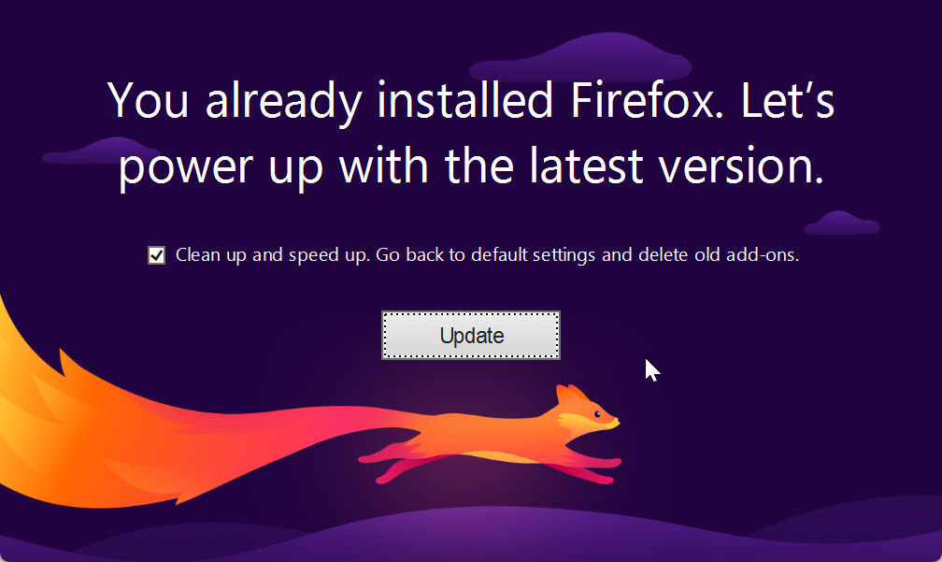

Slide 8
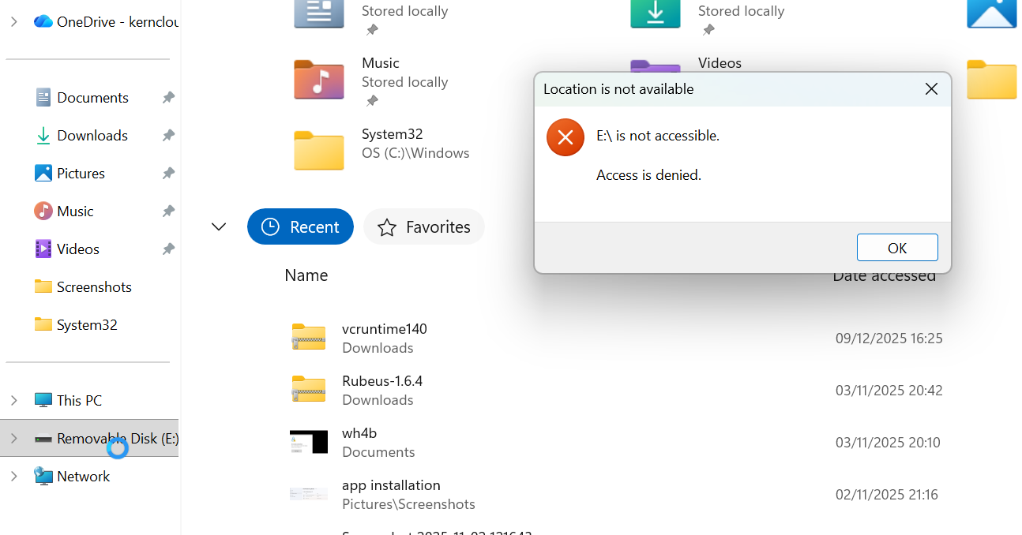

Slide 9
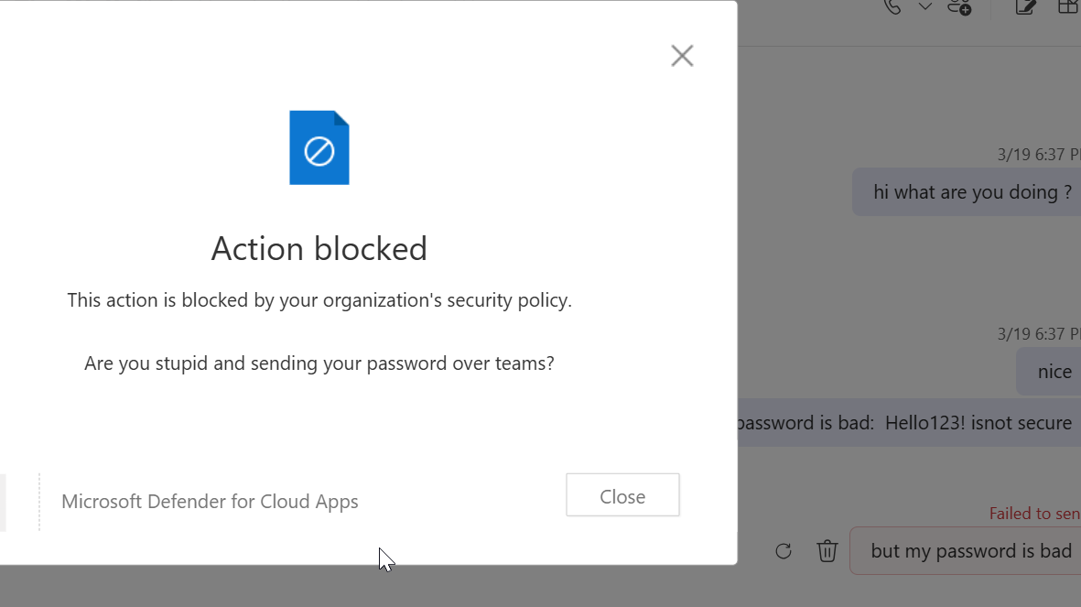

Slide 10
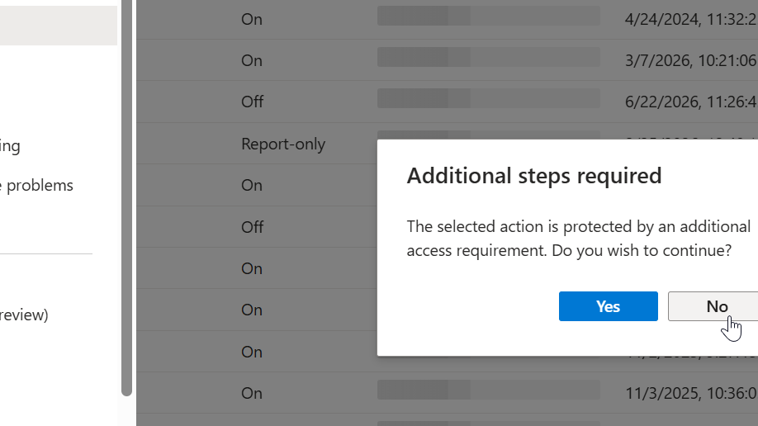

Slide 11
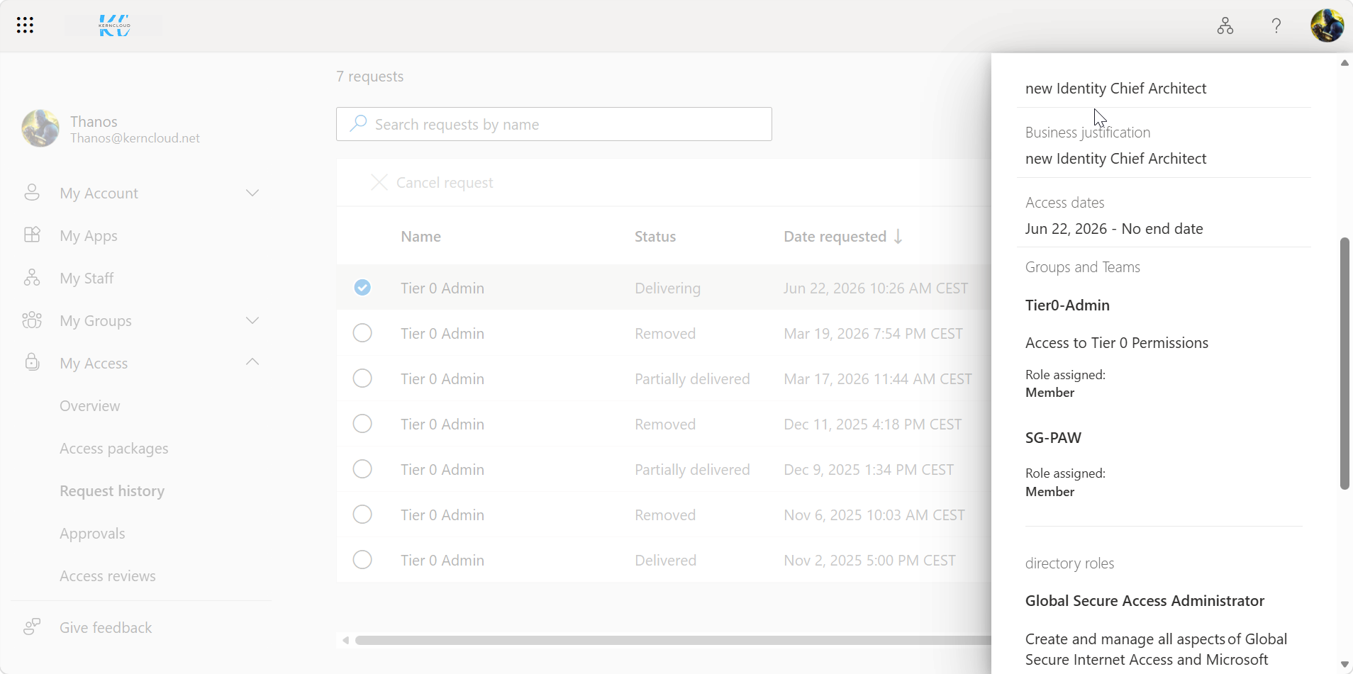

Slide 12
